Slide 1
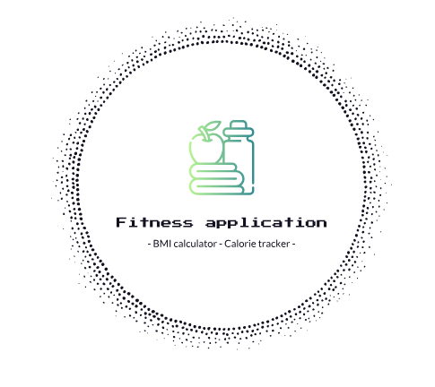
- Fitness Express -
Jordan A-McCendie, Jerwinson-Flores Cunanan, Dornaz Namazi, Aurelien Ebeng Djeungoue Mokube

Slide 2
Members
Jerwinson-Flores Cunanan
Jordan Artzy-McCendie
Dornaz Namazi
Aurelien Ebeng Djeungouue Mokube

Slide 3
What is Fitness Tracking App?
Android application
Uses a login
Calculates user BMI
Display all BMI records
Recommendations to attain BMI target
Calculates food calories
In order to help track fitness progress, and help user maintain a healthy lifestyle.

Slide 4
Objective of sprint
The objective is to find the functionalities of the application
Second is to find the user stories
Lastly, find the acceptance criteria

Slide 5
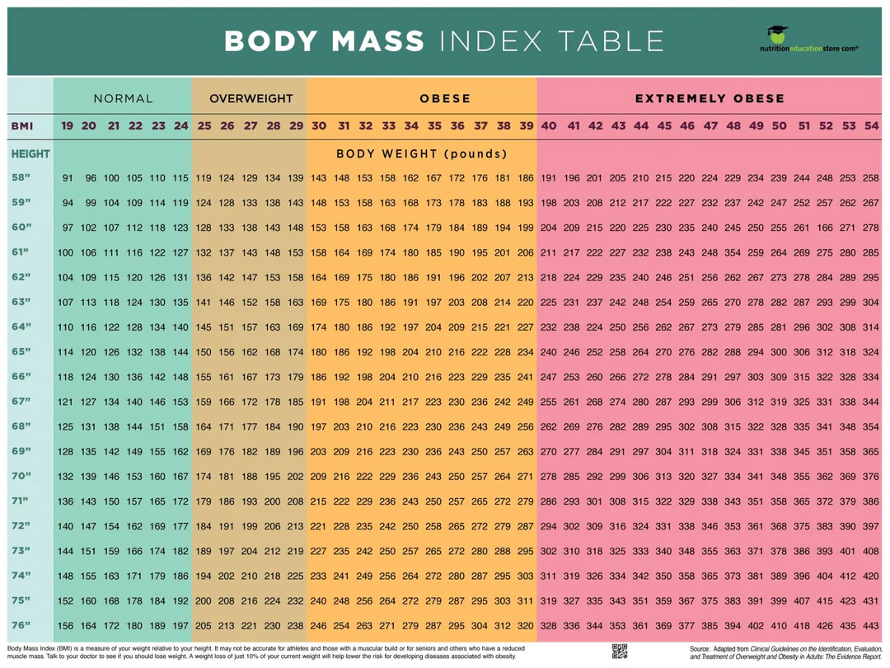
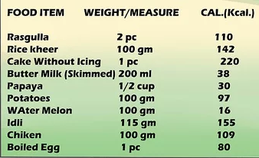
Functionalities:
1. BMI Management
2. Calorie Management
3. Access Management

Slide 6
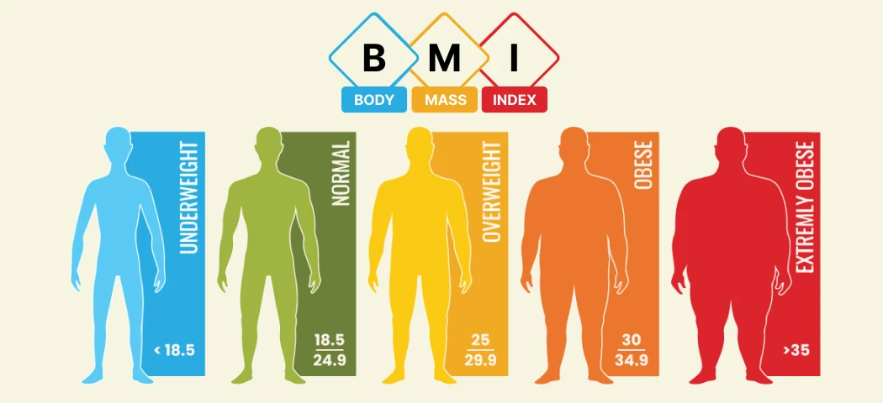
1. BMI Management
BMI Calculator
Different Measurement units
Display BMI
BMI Recommendations
Calculate regular BMI

Slide 7
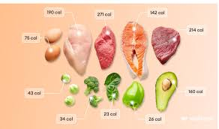
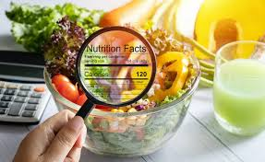
2. Calorie Management
Food database
Calorie tracker

Slide 8


3. Access Management
Login
Logout
Create account
Forgot Password
Edit Person, User Data

Slide 9

Role Distribution
Flores: UI, Backend, Database
Dornaz: Class diagram, testing
Jordan: UI, Backend
Aurelien: Backend

Slide 10

Access Management
Prioritised User Story

Slide 11
Login
Acceptance Criteria
Given I entered the correct User Id and Password
When I click Login
Then I am connected to the user Data and sent to the main page of the application

Slide 12
Logout
Acceptance Criteria
Given I am login to the user data
When I click Logout
Then I am disconnected to the user data and sent to the log in page

Slide 13
Create account
Acceptance Criteria
Given I don’t have a User data
When I click Create User
Then I am able to create a user data to login

Slide 14
Forgot Password
Acceptance Criteria
Given I don’t remember my user password
When I click Forgot Password
Then I can edit my user password

Slide 15
Edit Person, User Data
Acceptance Criteria
Given I am logged on the app
When I select edit user or person
Then I can edit user or person data.

Slide 16
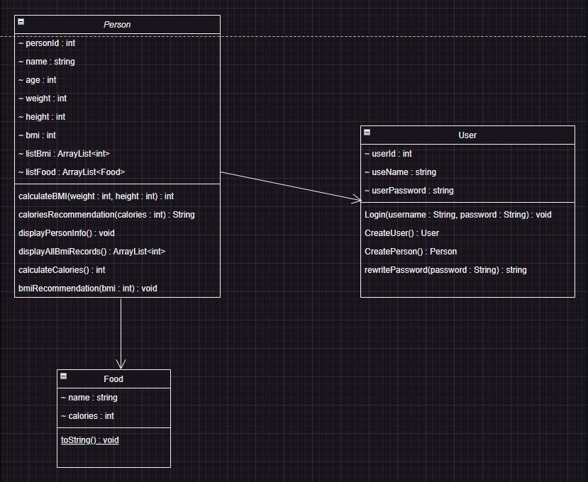
Class Diagram

Slide 17
What to improve?

